Slide 1
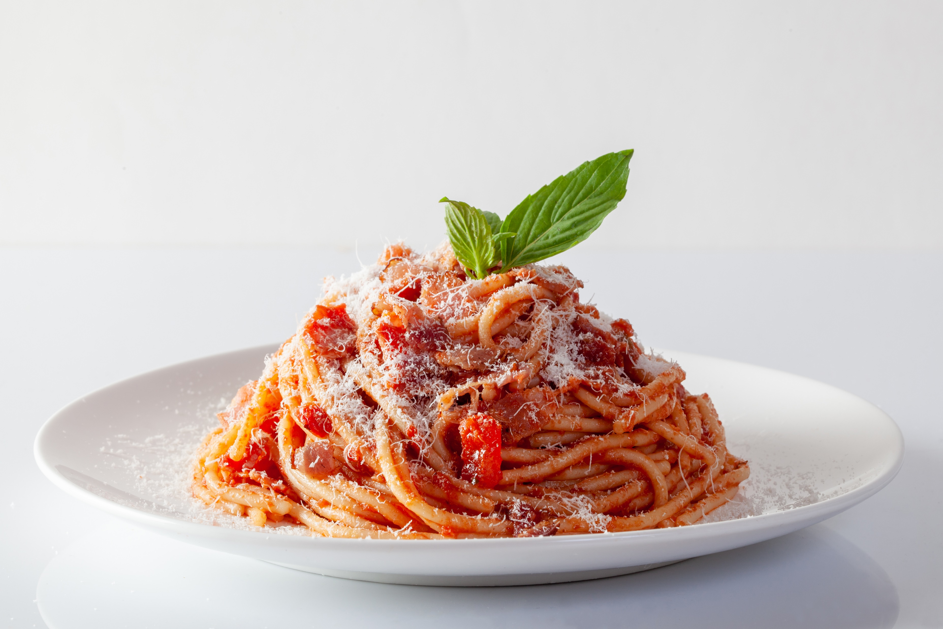
When: Sun., Feb. 18th
Time: 5:30 – 7:30
Where: Plymouth Town Hall
Plymouth Community
Free Spaghetti Dinner
Plymouth Emergency Services will be hosting another a free
community spaghetti dinner on Sunday, February 18 from
5:30 - 7:30 at the Plymouth Town hall. Come celebrate mid
winter and reunite with your friends and neighbors while
enjoying a great 'home cooked meal' .With the winter half
over it will be great just to laugh, share good times and enjoy
the community spirit!
The meal will consist of spaghetti, a choice of meat or
meatless sauce, rolls, butter, salad and dessert.
Donations accepted but not expected. We hope to see you there! Questions? call Sue at 802-236-2683.

